Slide 1
Team SCRANTON
Rajat Upadhyay
Rishabh Raizada

Slide 2
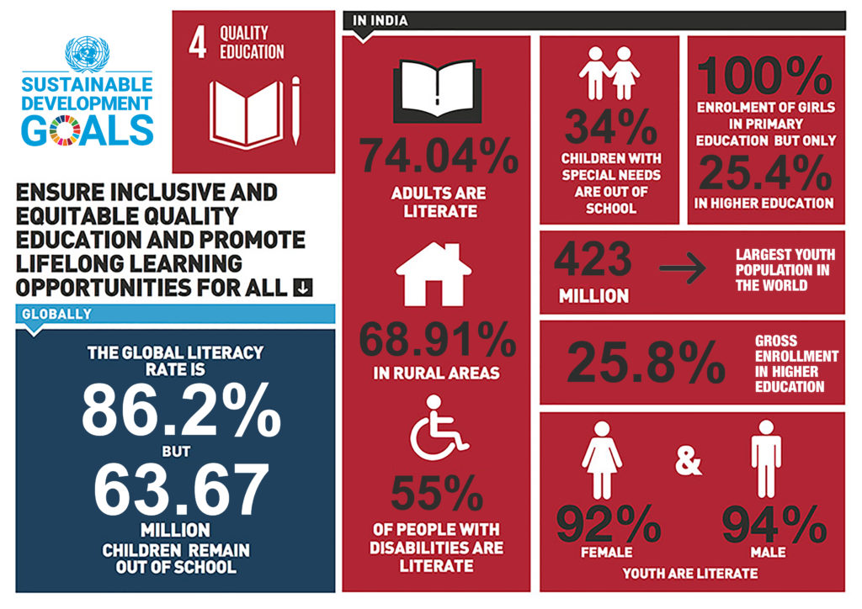

Slide 3
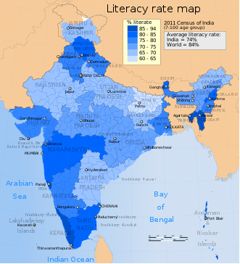
References and statistics
https://in.one.un.org/page/sustainable-development-goals/sdg-4/
https://www.campaignforeducation.org/en/who-we-are/the-international-education-framework-2/the-sustainable-development-goal-4/sdg4s-10-targets/?gclid=EAIaIQobChMIhZvcr7Ct5wIVigsrCh3h9wSpEAAYASAAEgIbX_D_BwE
https://en.wikipedia.org/wiki/Literacy_in_India

Slide 4
Problems we aim to solve

Slide 5
How it works?

Slide 6
Tech stack
Face-recognition:
Python, dlib, imutils, face_recognition, OpenCV
Front end:
HTML, CSS, Bootstrap, EJS templating engine
3. Back end:
MongoDB, NodeJS, ExpressJS.

Slide 7
Technical architecture
Register/Login to dashboard
Add money to wallet
Scan face during any transaction
FaceID is matched with the user’s wallet. Money is deducted.
Notification is sent to both user and shop
Unique transaction id is generated for future reference

Slide 8
What’s next?
Use dedicated camera with night vision.
Linking multiple face ids with one account.
Modify system to work with Metro/Railway stations.
Strong servers and scalability.
Integration with ecommerce website.

Slide 9
Extra Benefits
No pollution due to thermally generated receipts, thus saving 10M trees a year.
Less demand for plastic cards for payments.
Monthly accounting becomes really easy.

Slide 10
REFERENCES
https://www.enn.com/articles/48125-how-the-credit-card-industry-is-contributing-to-pollution
https://slate.com/technology/2009/04/is-cash-better-for-the-environment-than-a-credit-card.html
http://www.climateaction.org/news/report-skip-the-slip-environmental-costs-human-health-risks-of-paper-receip

Slide 11
THANK YOU

